Slide 1
Improving MMD-GAN Training with Repulsive Loss Function
Wei Wang, Yuan Sun, Saman Halgamuge
International Conference on Learning Representation (ICLR)
New Orleans, 2019

Slide 2
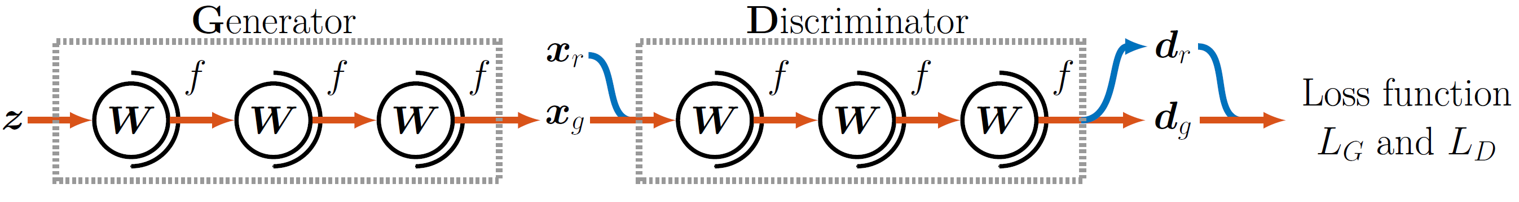

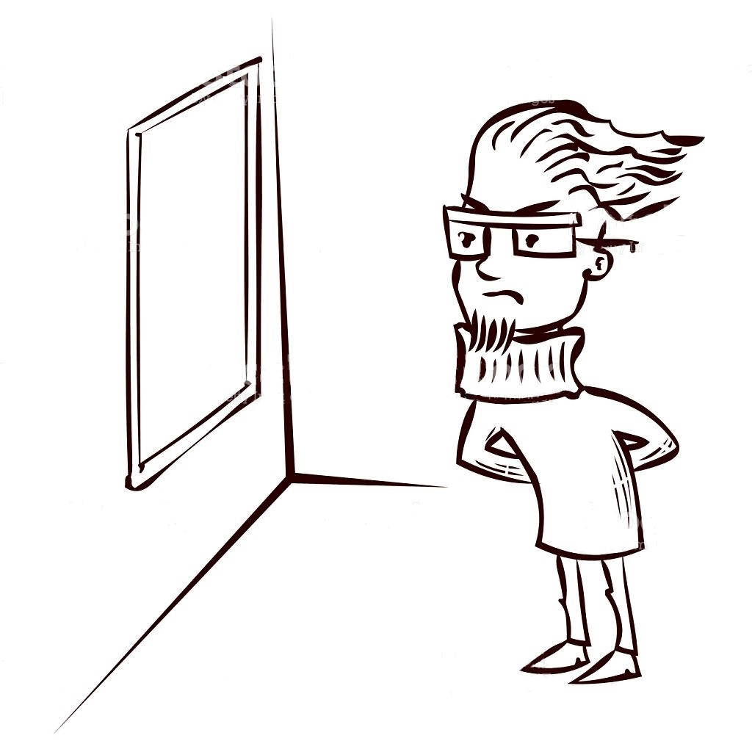
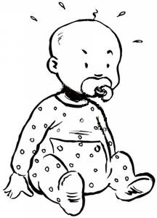
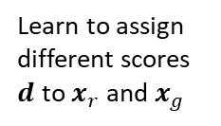
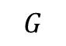
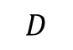
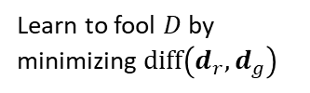

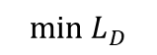
$$G$$
$$D$$
$$\min{L_{G}}$$
$$\min{L_{D}}$$
Learn to fool $D$ by minimizing $diff\left(d_{r},d_{g}\right)$
Learn to assign different scores $d$ to $x_{r}$ and $x_{g}$

Slide 3
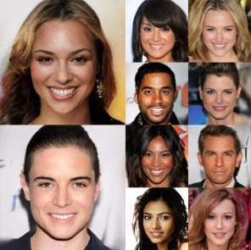
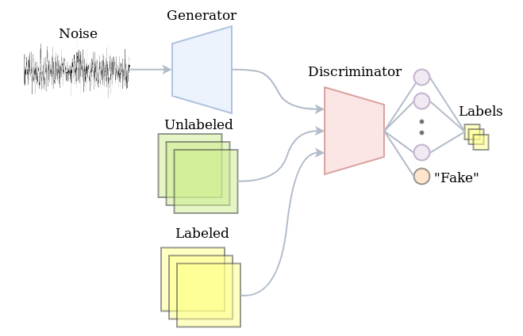
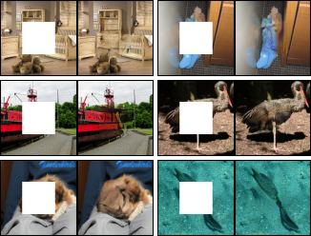
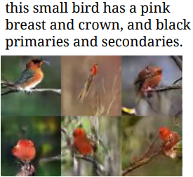
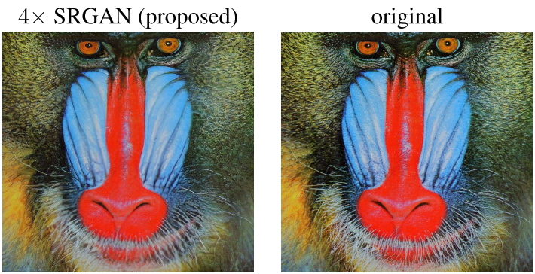
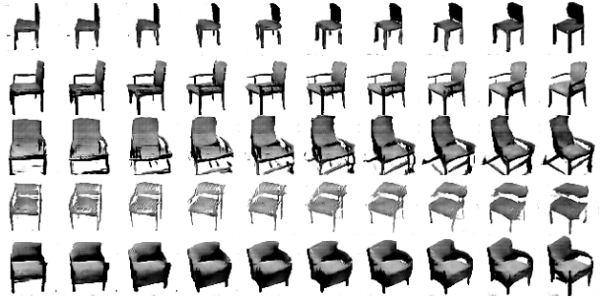
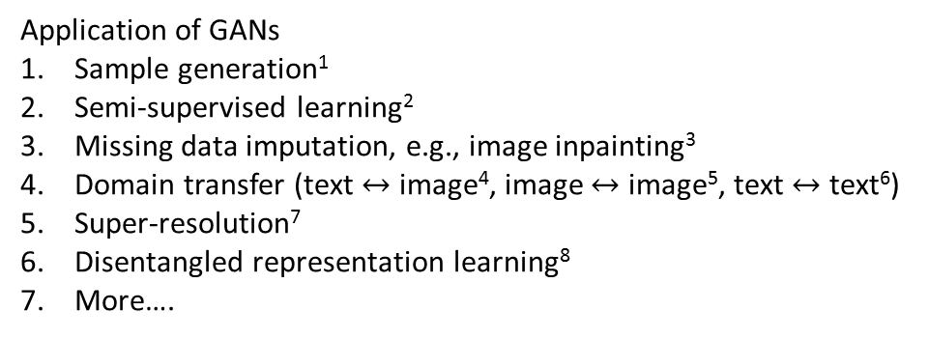
1
2
3
Application of GANs
Sample generation¹
Semi-supervised learning²
Missing data imputation, e.g., image inpainting³
Domain transfer (text $↔$ image⁴, image $↔$ image⁵, text $↔$ text⁶)
Super-resolution⁷
Disentangled representation learning⁸
More….
4
5
6

Slide 4
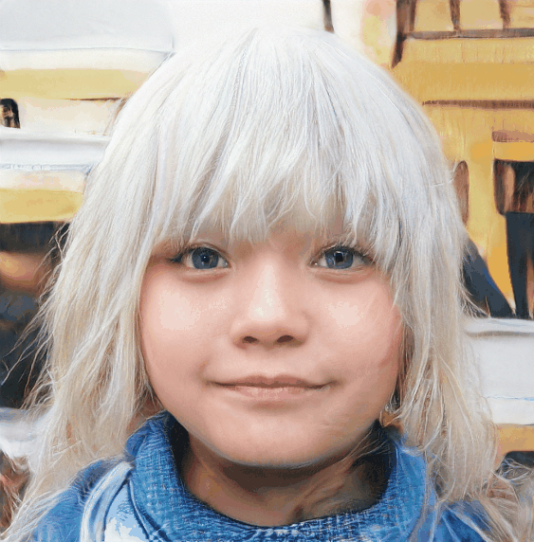
Human faces generated by style generative adversarial nets [19]
Img src: https://thispersondoesnotexist.com/
Refresh this page, you’ll get a different face each time!

Slide 5
https://www.youtube.com/watch?v=PCBTZh41Ris
[20] deepfake dancing using recurrent neural networks (RNN) and GANs

Slide 6
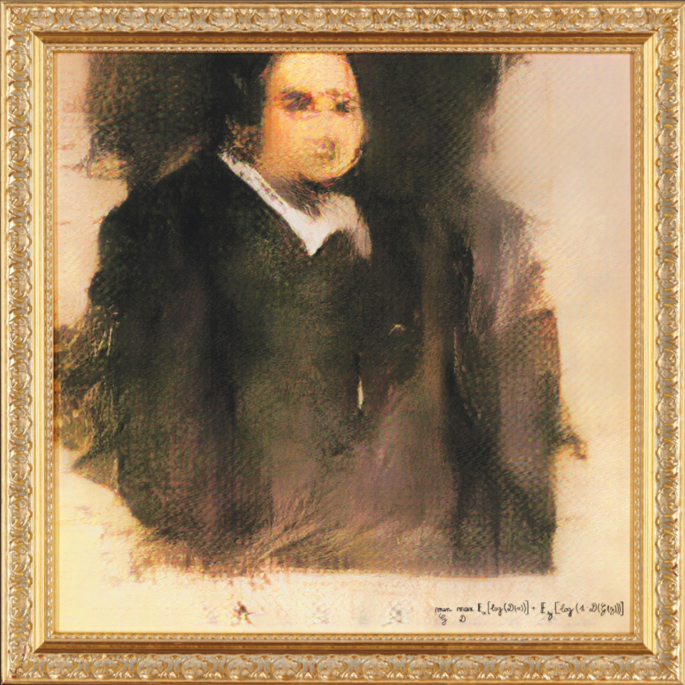
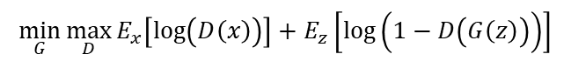
Edmond De Belamy, 2018, created by GAN.
Sold for USD $432,500.
$$\min_{G}{\max_{D}{E_{x}\left[\log\left(D\left(x\right)\right)\right]+E_{z}\left[\log\left(1−D\left(G\left(z\right)\right)\right)\right]}}$$

Slide 7
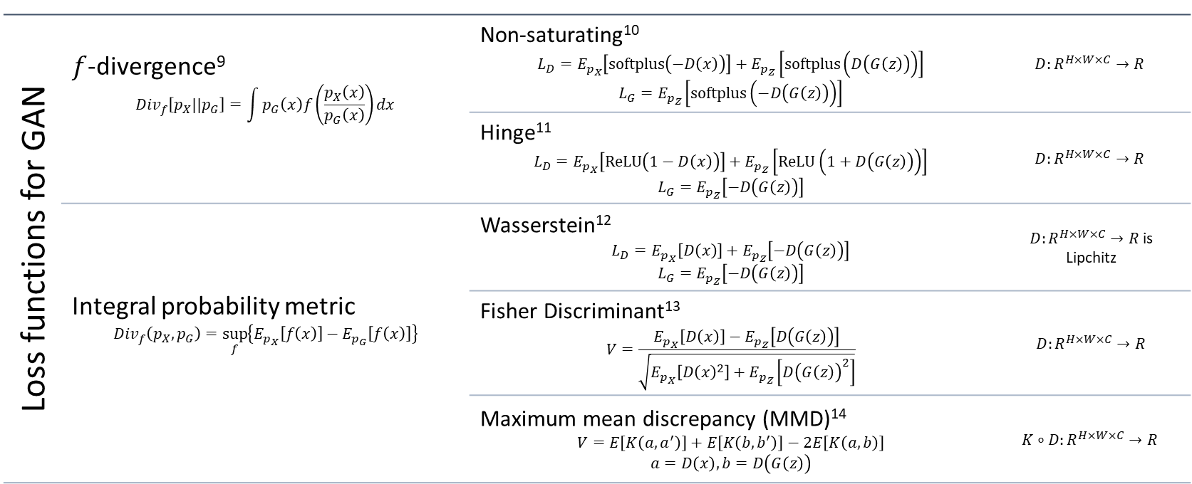
Loss functions for GAN | $f$-divergence⁹ $${Div}_{f}\left[p_{X}||p_{G}\right]=\int{p_{G}\left(x\right)f\left(\frac{p_{X}\left(x\right)}{p_{G}\left(x\right)}\right)dx}$$ | Non-saturating¹⁰ $$L_{D}=E_{p_{X}}\left[softplus\left(−D\left(x\right)\right)\right]+E_{p_{Z}}\left[softplus\left(D\left(G\left(z\right)\right)\right)\right]$$ $$L_{G}=E_{p_{Z}}\left[softplus\left(−D\left(G\left(z\right)\right)\right)\right]$$ | $$D:R^{H×W×C}→R$$
 |  | Hinge¹¹ $$L_{D}=E_{p_{X}}\left[ReLU\left(1−D\left(x\right)\right)\right]+E_{p_{Z}}\left[ReLU\left(1+D\left(G\left(z\right)\right)\right)\right]$$ $$L_{G}=E_{p_{Z}}\left[−D\left(G\left(z\right)\right)\right]$$ | $$D:R^{H×W×C}→R$$
 | Integral probability metric $${Div}_{f}\left(p_{X},p_{G}\right)=\sup_{f}\left\{E_{p_{X}}\left[f\left(x\right)\right]−E_{p_{G}}\left[f\left(x\right)\right]\right\}$$ | Wasserstein¹² $$L_{D}=E_{p_{X}}\left[D\left(x\right)\right]+E_{p_{Z}}\left[−D\left(G\left(z\right)\right)\right]$$ $$L_{G}=E_{p_{Z}}\left[−D\left(G\left(z\right)\right)\right]$$ | $D:R^{H×W×C}→R$ is Lipchitz
 |  | Fisher Discriminant¹³ $$V=\frac{E_{p_{X}}\left[D\left(x\right)\right]−E_{p_{Z}}\left[D\left(G\left(z\right)\right)\right]}{\sqrt{E_{p_{X}}\left[D{\left(x\right)}^{2}\right]+E_{p_{Z}}\left[D{\left(G\left(z\right)\right)}^{2}\right]}}$$ | $D:R^{H×W×C}→R$
 |  | Maximum mean discrepancy (MMD)¹⁴ $$V=E\left[K\left(a,a^{′}\right)\right]+E\left[K\left(b,b^{′}\right)\right]−2E\left[K\left(a,b\right)\right]$$ $$a=D\left(x\right),b=D\left(G\left(z\right)\right)$$ | $$K∘D:R^{H×W×C}→R$$

Slide 8
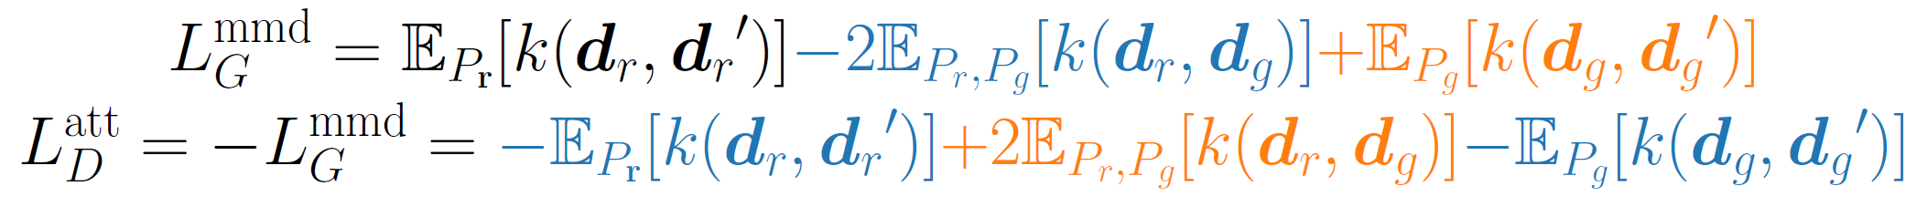
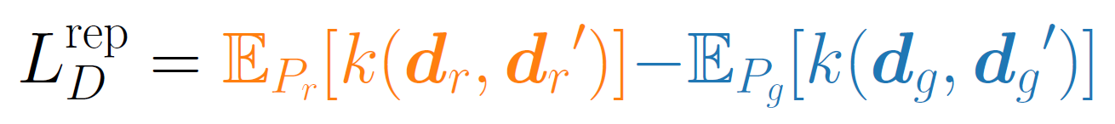
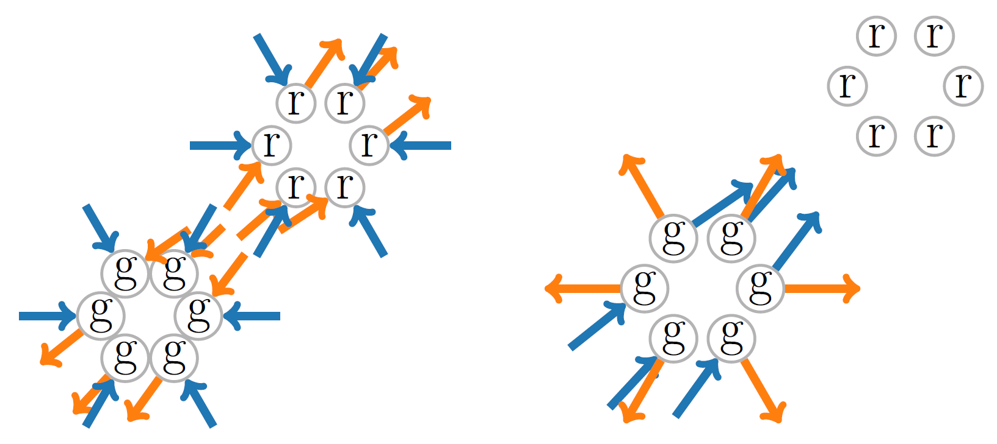
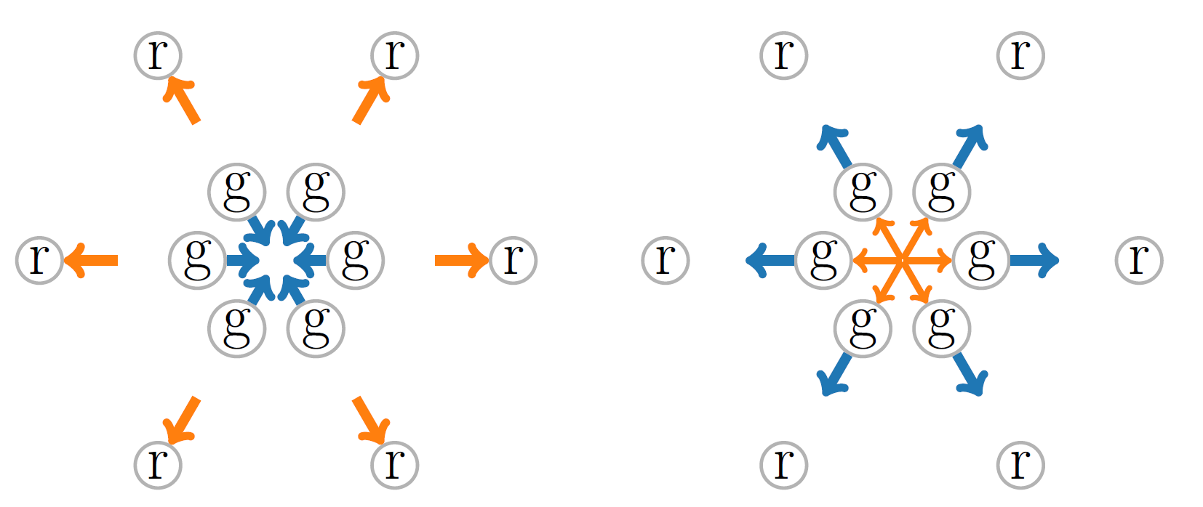

Slide 9
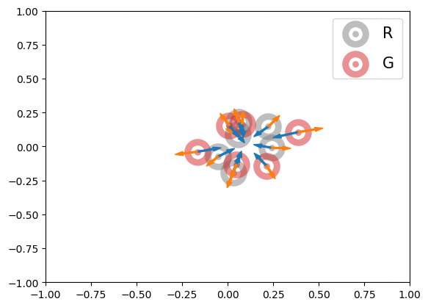

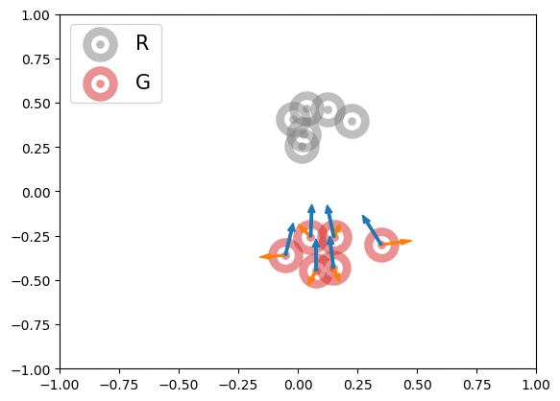
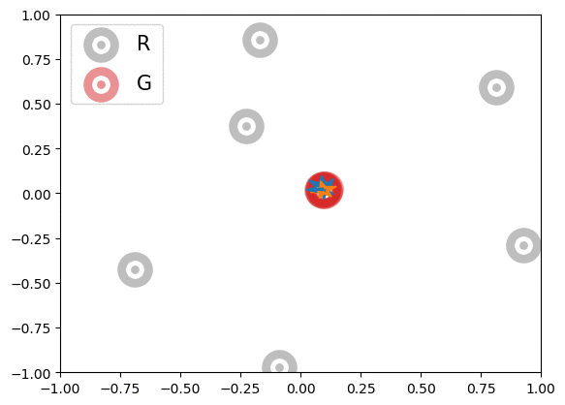
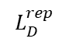
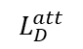
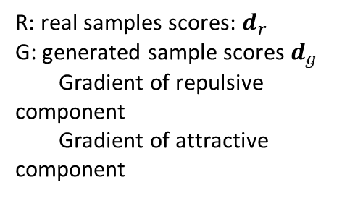
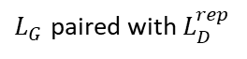
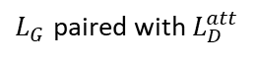
Illustration of effects of loss functions on free particles
R: real samples scores: $d_{r}$
G: generated sample scores $d_{g}$
Gradient of repulsive component
Gradient of attractive component
$$L_{D}^{att}$$
$$L_{D}^{rep}$$
$L_{G}$ paired with $L_{D}^{att}$
$L_{G}$ paired with $L_{D}^{rep}$
Notes:
Gaussian kernel $k\left(a,b\right)=\exp\left(−\left\|a−b\right\|\right)$ is used.

Slide 10



Slide 11
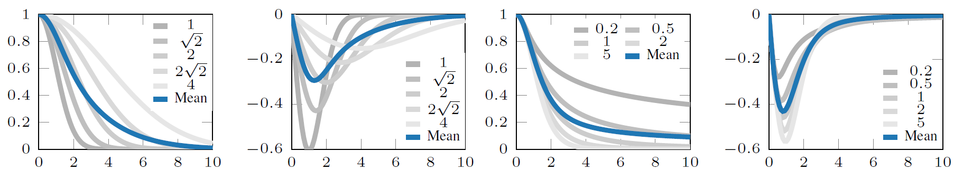
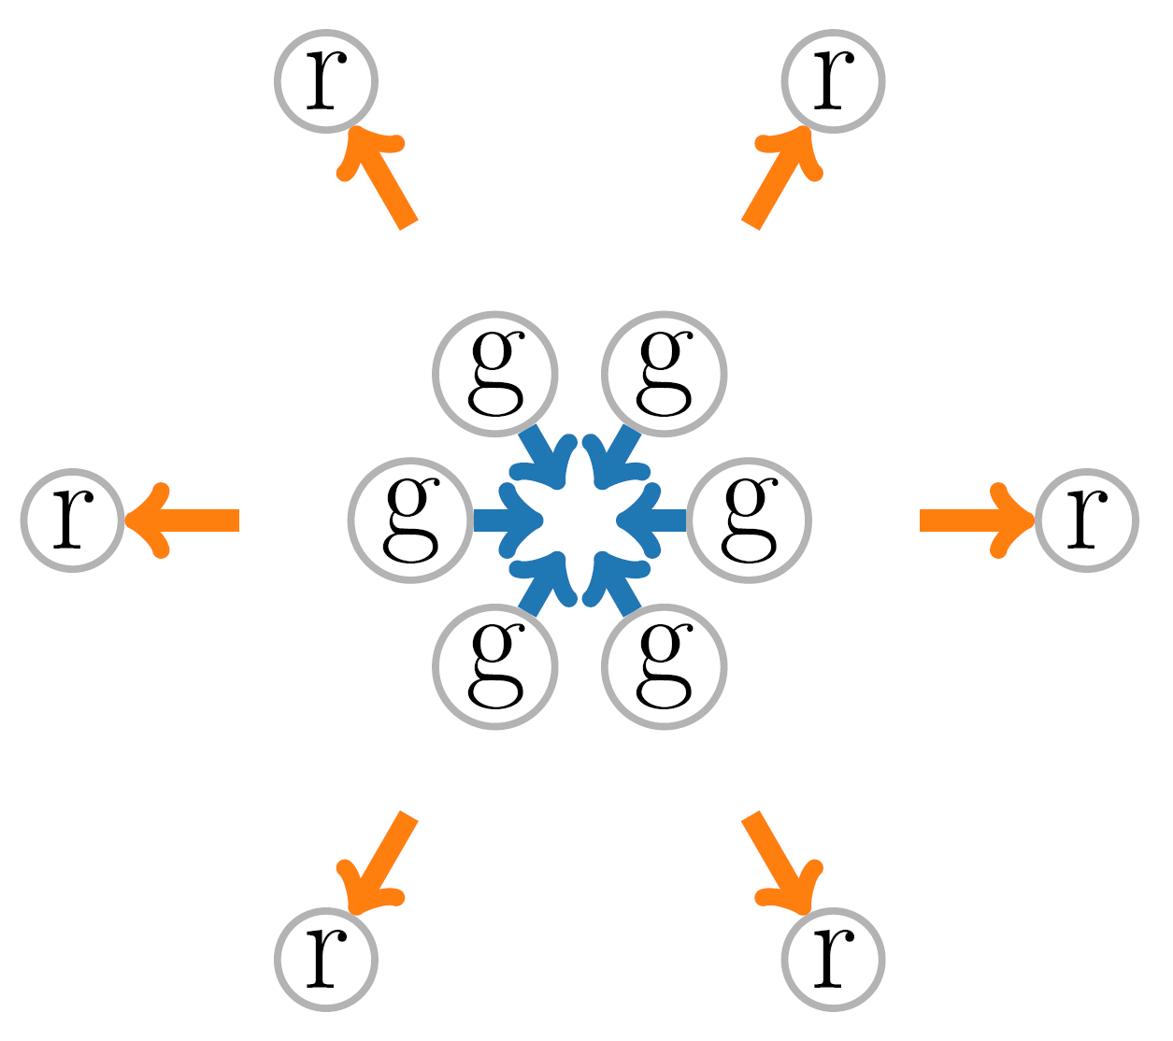
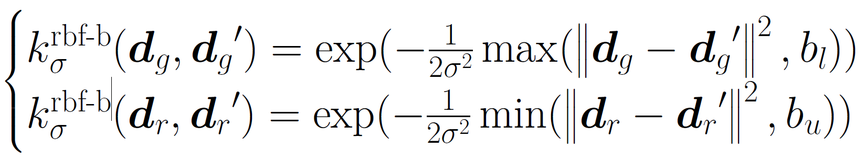
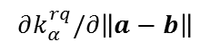
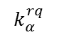
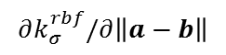
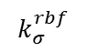
$$k_{σ}^{rbf}$$
$$∂k_{σ}^{rbf}/∂\left\|a−b\right\|$$
$$k_{α}^{rq}$$
$$∂k_{α}^{rq}/∂\left\|a−b\right\|$$

Slide 12
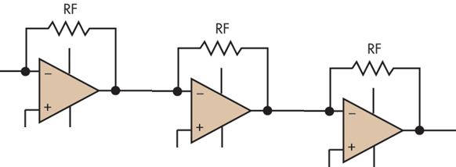
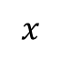
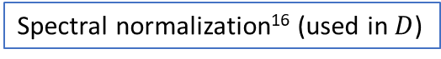
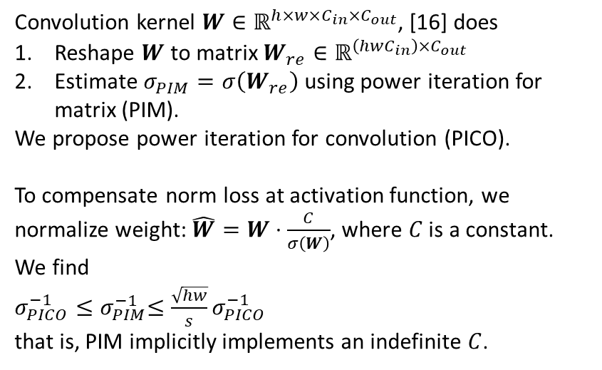
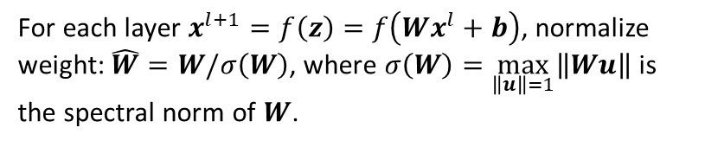
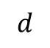
Convolution kernel $W∈ℝ^{h×w×C_{in}×C_{out}}$, [16] does
Reshape $W$ to matrix $W_{re}∈ℝ^{\left(hwC_{in}\right)×C_{out}}$
Estimate $σ_{PIM}=σ\left(W_{re}\right)$ using power iteration for matrix (PIM).
We propose power iteration for convolution (PICO).
To compensate norm loss at activation function, we normalize weight: $\hat{W}=W⋅\frac{C}{σ\left(W\right)}$, where $C$ is a constant.
We find
$σ_{PICO}^{−1}{≤σ}_{PIM}^{−1}≤\frac{\sqrt{hw}}{s}σ_{PICO}^{−1}$
that is, PIM implicitly implements an indefinite $C$.
$$x$$
$$d$$
Spectral normalization¹⁶ (used in $D$)
For each layer $x^{l+1}=f\left(z\right)=f\left(Wx^{l}+b\right)$, normalize weight: $\hat{W}=W/σ\left(W\right)$, where $σ\left(W\right)=\max_{\left\|u\right\|=1}\left\|Wu\right\|$ is the spectral norm of $W$.
Notes:
Spectral normalization imposes a Lipschitz constraint on the discriminator, i.e., $D$ has to be Lipschitz continuous.

Slide 13
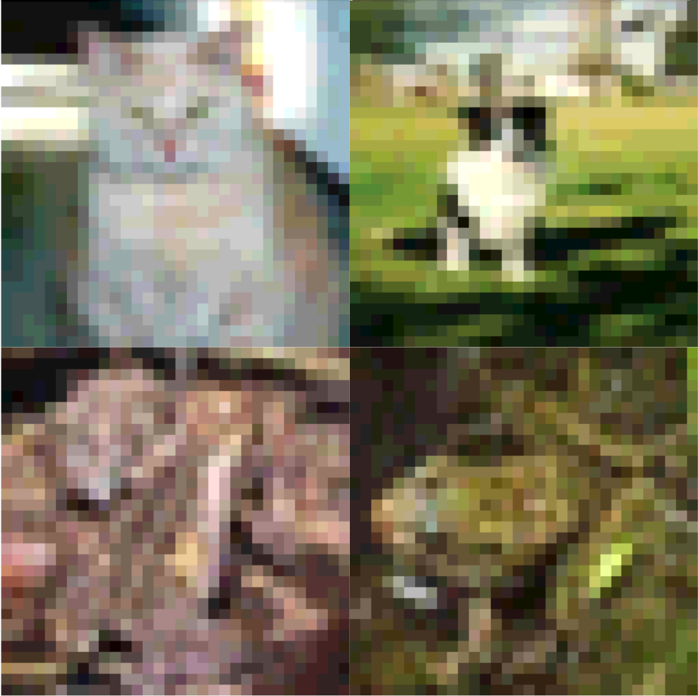
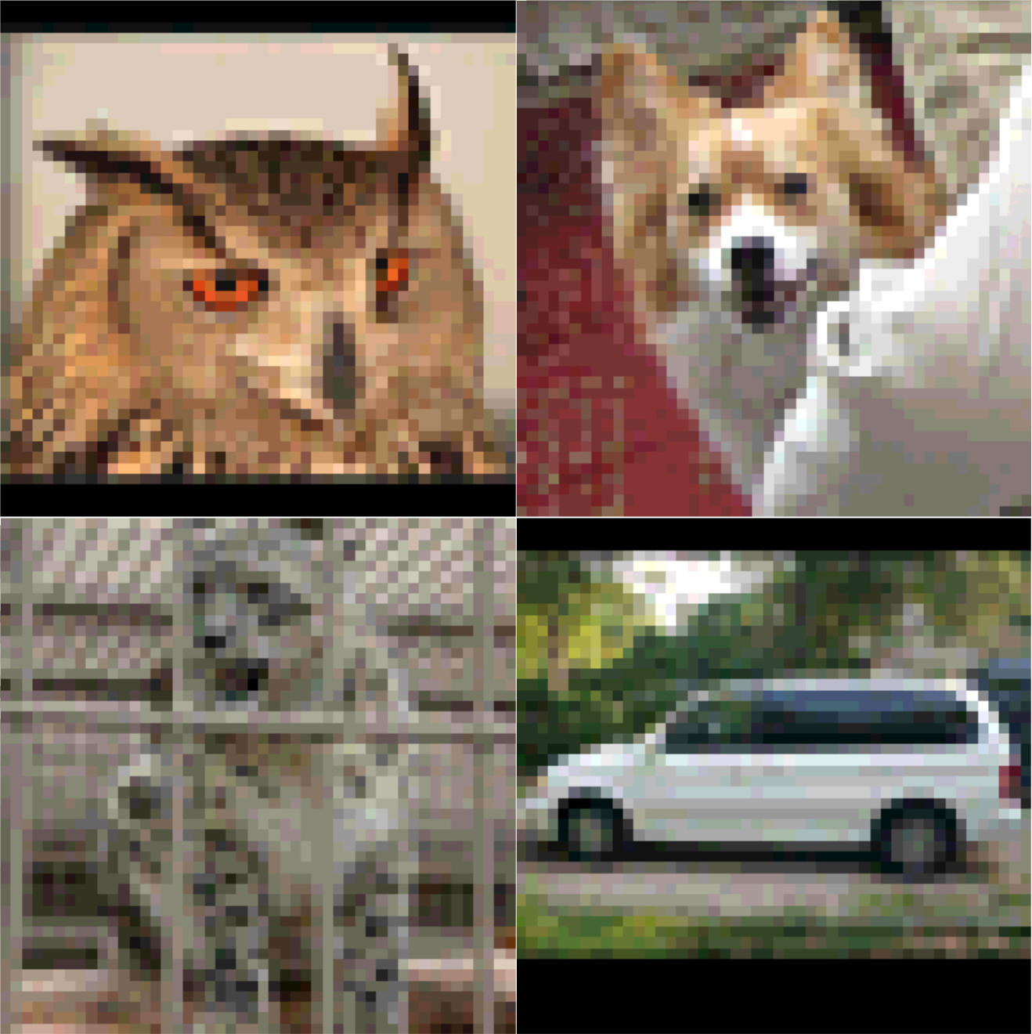
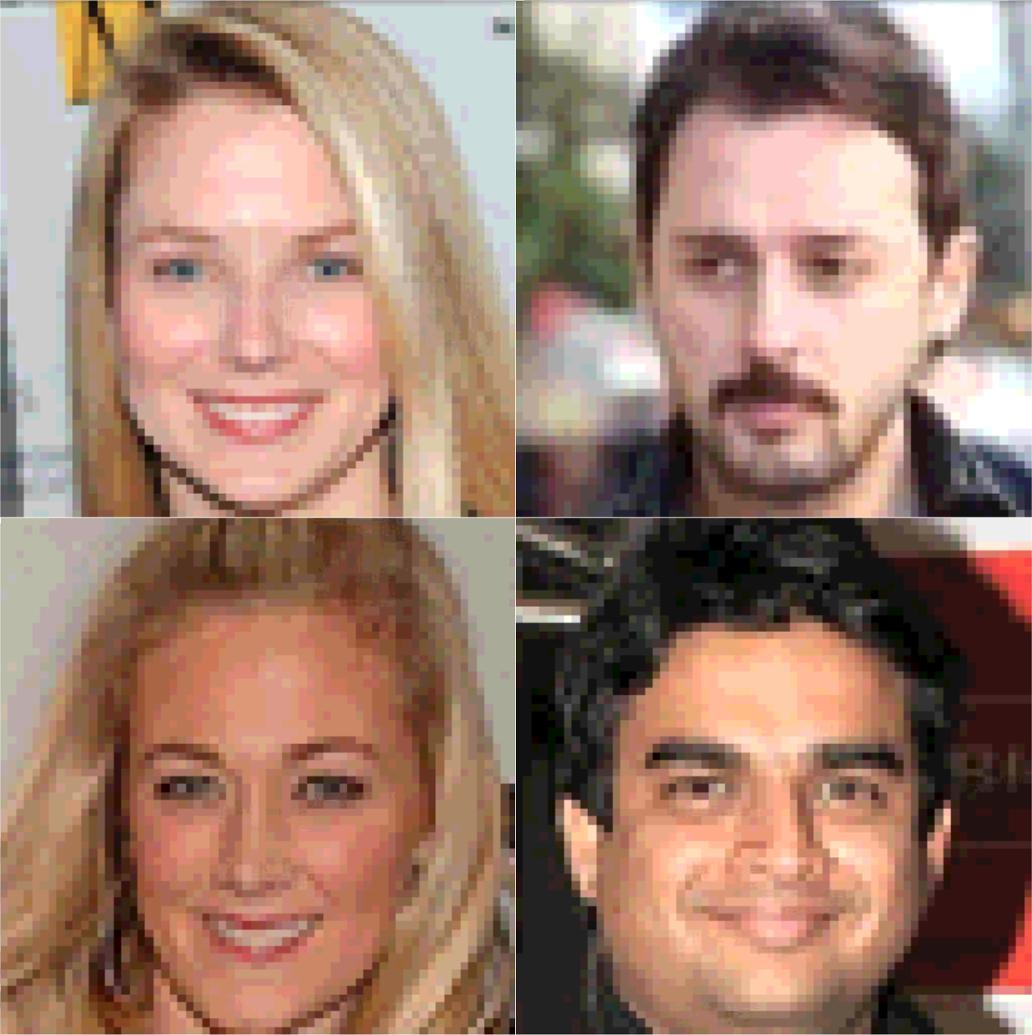
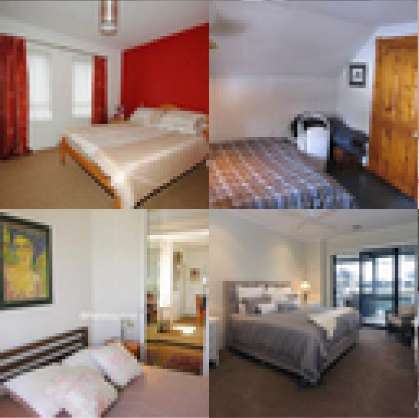
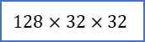
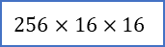













Dataset:
CIFAR-10
STL-10
CelebA
LSUN-bedroom
Hyper-parameters:
TTUR learning rate schedule, $\left\{{10}^{−4},2×{10}^{−4},5×{10}^{−4},{10}^{−3}\right\}$
100k iterations.
Network structure:
Generator
$$128$$
$$1024×4×4$$
$$512×8×8$$
$$256×16×16$$
$$128×32×32$$
$$64×64×64$$
$$3×64×64$$
Discriminator
$$512×8×8$$
$$256×16×16$$
$$256×16×16$$
$$128×32×32$$
$$128×32×32$$
$$64×64×64$$
$$512×8×8$$
$$1024×4×4$$
$$1024×4×4$$
$1$ or $16$
Batch normalization is used in generator, while spectral normalization with PICO ($C=1.82$) used in discriminator.
Evaluation metrics:
IS: inception score; higher is better;
FID: Fréchet Inception Distance; lower is better;
MS-SSIM: multi-scale structural similarity; lower is better
Notes:
TTUR learning rate schedule means the discriminator and generator may have different learning rate
In the network structure, each block shows the size of output
1 for non-saturating and hinge loss, 16 for MMD related loss

Slide 14

Methods:
MMD-rbf: MM-GAN with Gaussian kernel¹⁴
MMD-rq: MMD-GAN with quadratic kernel¹⁷
MMD-rbf-b: MMD-GAN with bounded Gaussian kernel
MMD-rep: MMD-GAN with repulsive loss (and Gaussian kernel)
MMD-rep-b: MMD-GAN with repulsive loss and bounded Gaussian kernel

Slide 15


A general form of loss function for $D$:
$$L_{D}=λE_{P_{X}}\left[k\left(D\left(x\right),D\left(x^{′}\right)\right)\right]−\left(λ−1\right)E_{p_{X},p_{Y}}\left[k\left(D\left(x\right),D\left(y\right)\right)\right]−E_{p_{Y}}\left[k\left(D\left(y\right),D\left(y^{′}\right)\right)\right]$$
$λ=−1$, the attractive loss $L_{D}^{att}=−V\left(G,D\right)$
$λ=1$, the proposed repulsive loss $L_{D}^{rep}$
Notes:
The colours stands for different learning rate combination for discriminator and generator

Slide 16


Slide 17








Paper (arXiv)
1812.09916
Code (Github)
richardwth/MMD-GAN
Impact of constant $C$ in PICO
Stability analysis
Best FID scores by PICO and PIM
Lipschitz constraint via gradient penalty
Impact of discriminator output dimension

Slide 18

Reference
Tero Karras, et al. Progressive Growing of GANs for Improved Quality, Stability and Variation. ICLR, 2018.
Tim Salimans, et al. Improved Techniques for Training GANs. NeurIPS, 2016.
Deepak Pathak, et al. Context Encoders: Feature Learning by Inpainting. CVPR, 2016.
Scott Reed, et al. Generative Adversarial Text to Image Synthesis. ICML, 2016.
Jun-Yan Zhu, et al. Unpaired Image-to-Image Translation using Cycle-Consistent Adversarial Networks. ICML, 2017.
Guillaume Lample, et al. Unsupervised Machine Translation Using Monolingual Corpora Only. ICLR 2018.
Christian Ledig, et al. Photo-Realistic Single Image Super-Resolution Using a Generative Adversarial Network. CVPR, 2017.
Xi Chen, et al. InfoGAN: Interpretable Representation Learning by Information Maximizing Generative Adversarial Nets. NeurIPS, 2016.
Sebastian Nowozin, et al. $f$-GAN: Training generative neural samplers using variational divergence minimization. NeurIPS, 2016.
Ian J. Goodfellow, et al. Generative Adversarial Nets. NeurIPS, 2014.
Dustin Tran, et al. Hierarchical Implicit Models and Likelihood-free Variational Inference. arXiv:1702.08896.
Ishaan Gulrajani, et al. Improved Training of Wasserstein GANs. NeurIPS, 2017.
Youssef Mroueh, Tom Sercu. Fisher GAN. NeurIPS, 2017.
Chun-Liang Li, et al. MMD GAN: Towards Deeper Understanding of Moment Matching Network. NeurIPS, 2017.
Sergey Ioffe and Christian Szegedy. Batch Normalization: Accelerating Deep Network Training by Reducing Internal Covariate Shift. ICML, 2015.
Takeru Miyato, et al. Spectral Normalization for Generative Adversarial Networks. ICLR, 2018.
Mikołaj Bińkowski, et al. Demystifying MMD GANs. ICLR, 2018.
Michael Arbel, et al. On Gradient Regularizers for MMD GANs. NeurIPS, 2018.
Karras, T., et al. (2018). A style-based generator architecture for generative adversarial networks. arXiv:1812.04948.
Chan, C., Ginosar, S., Zhou, T., & Efros, A. A. (2018). Everybody dance now. arXiv preprint arXiv:1808.07371.

